Slide 1
UNIT 4 :Simplification of Boolean Algebra
Presented by
Er.Harendra Bikram Shah
(Lecturer)

Slide 2
OUTLINES
K-Map of 2,3,4 variables
Simplification and Realization using NAND and NOR gates
Practical Design Steps

Slide 3
K-Map
Introduction to K-map:
In previous chapters, we have simplified the Boolean functions using Boolean postulates and theorems.
It is a time consuming process and we have to re-write the simplified expressions after each step.
To overcome this difficulty, Karnaugh introduced a method for simplification of Boolean functions in an easy way.
A Karnaugh map (K-map) is a pictorial method used to minimize Boolean expressions without having to use Boolean algebra theorems and equation manipulations.
A K-map can be thought of as a special version of a truth table .
It is a graphical method, which consists of 2n cells for ‘n’ variables.
In 1953, the American Physicist Maurice Karnaugh invented K-Map

Slide 4
K-Map
Significance/Application/Importance of K-map:
Boolean algebra can be simplified systematically
K-map reduces logic functions quickly and simply.
K-maps are both faster and Easier for more number for variables like 4 or more numbers of variables.

Slide 5
Steps to solve expression using K-map-
Select K-map according to the number of variables.
Identify minterms or maxterms as given in problem.
For SOP put 1’s in blocks of K-map respective to the minterms (0’s elsewhere).
For POS put 0’s in blocks of K-map respective to the maxterms(1’s elsewhere).
Make rectangular groups containing total terms in power of two like 2,4,8 ..(except 1) and try to cover as many elements as you can in one group.
Don’t care “x” should also be included while grouping to make a larger possible group.
From the groups made in step 5 find the product terms and sum them up for SOP form.

Slide 6
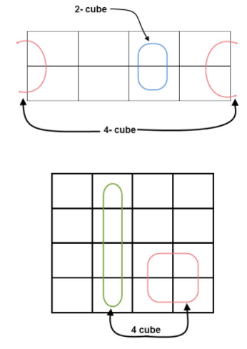
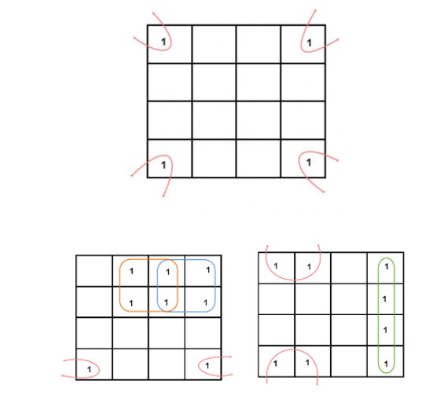
Pairing Ways in k-map

Slide 7
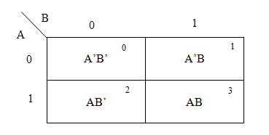
K-Map of 2 variables
SOP FORM

Slide 8
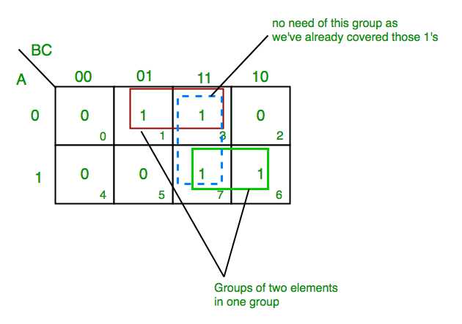
K-Map of 3 variables
SOP FORM
K-map of 3 variables-
Z= ∑A,B,C(1,3,6,7)
From red group we get product term—
A’C
From green group we get product term—
AB
Summing these product terms we get- Final expression (A’C+AB)

Slide 9
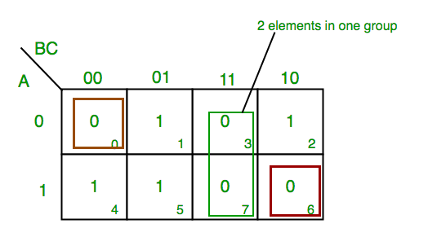
K-Map of 3 variables
SoP FORM

Slide 10
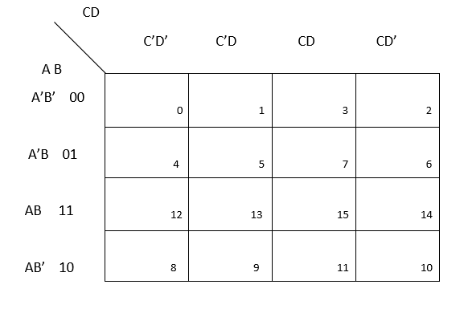
K-Map of 4 variables
SoP FORM

Slide 11
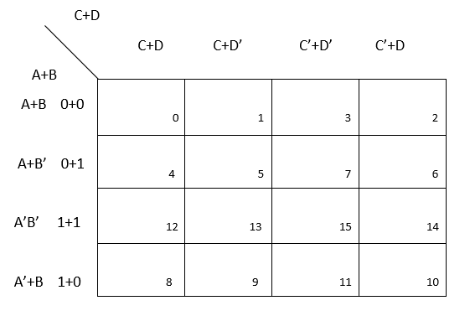
K-Map of 4 variables
PoS FORM

Slide 12
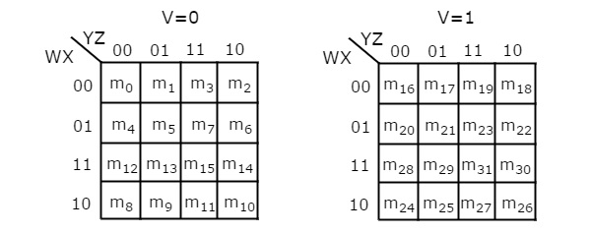
5 Variable K-Map
The number of cells in 5 variable K-map is thirty-two, since the number of variables is 5.
The following figure shows 5 variable K-Map.
There is only one possibility of grouping 32 adjacent min terms.
There are two possibilities of grouping 16 adjacent min terms. i.e.,
grouping of min terms from m0 to m15 and m16 to m31.
If v=0, then 5 variable K-map becomes 4 variable K-map.
In the above all K-maps, we used exclusively the min terms notation.
Similarly, you can use exclusively the Max terms notation.

Slide 13
K-Map with Don’t care
Everything is same except the notation ‘X’ is used for don’t care condition
Don’t care condition will remain same for both POS and SOP form

